Slide 1
Avoiding Terminations, Single Offer Competition, and Costly Changes with Fixed Price Contracts
Greg Sanders, Fellow, Defense-Industrial Initiatives Group
Andrew Hunter, Director, Defense-Industrial Initiatives Group and Senior Fellow, International Security Program
May 13, 2015

Slide 2
Methodology
This slide describes the overall methodology employed to develop this dataset. Aggregated data downloads from FPDS are unavailable for pre-2000 data, requiring a different approach.
The data set of approximately six million entries includes all contracts in the Federal Procurement Data System (FPDS) completed between FY2007 and FY2013.
Federal regulations require only that all unclassified prime contracts worth $2,500 and above be reported to FPDS.
FPDS data are constantly being updated, including those for back years. As a consequence, the dollar totals for a given year may have changed since the data was downloaded.
All dollar figures are in current dollars because contract ceilings do not account for inflation.

Slide 3
Dependent Variable: Number of offers

Slide 4
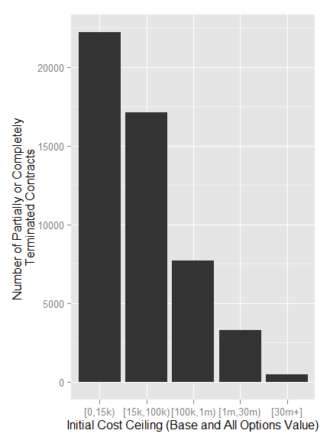
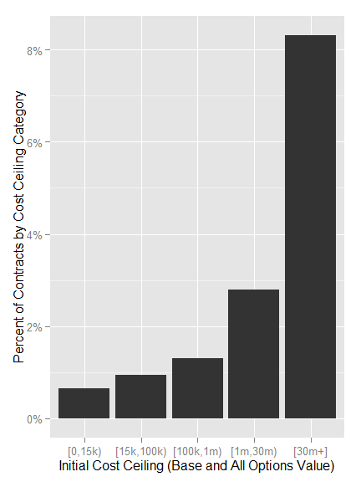
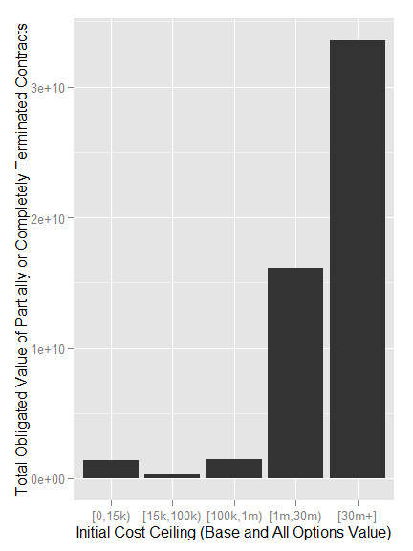
Dependent Variable: Terminations

Slide 5
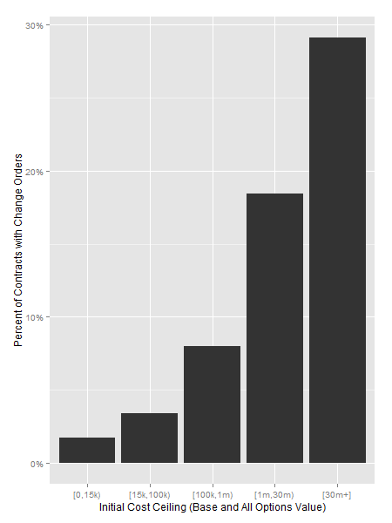
Dependent Variable: Number of Change Orders

Slide 6
Dependent Variable: Cost Ceiling-Raising Change Orders

Slide 7
Introduction to Bayesian Networks
The model is based on Bayesian inferential statistics, and relates the odds of an event (Event A1) to the odds of another event (Event A2) before and after the occurrence of some other event (Event B).
It is a way of representing a set of variables nodes and their conditional dependencies via a directed acyclic graph (DAG).
Because a Bayesian network is a complete model for variables and their relationships, it can be used to answer probabilistic queries about them.
The model is built in the open source statistical programming language R using two modules. The module BnLearn is used for the Bayesian network learning process, which turns the collected data into a DAG.
The module gRain is used for the second part of the process, creating the conditional probability table and then querying the resulting multiples.
The data and the open source processing and analytic programming code used to implement this process are available through the CSISdefense fixed price GitHub repository (Available at: https://github.com/CSISdefense/Fixed-price)

Slide 8
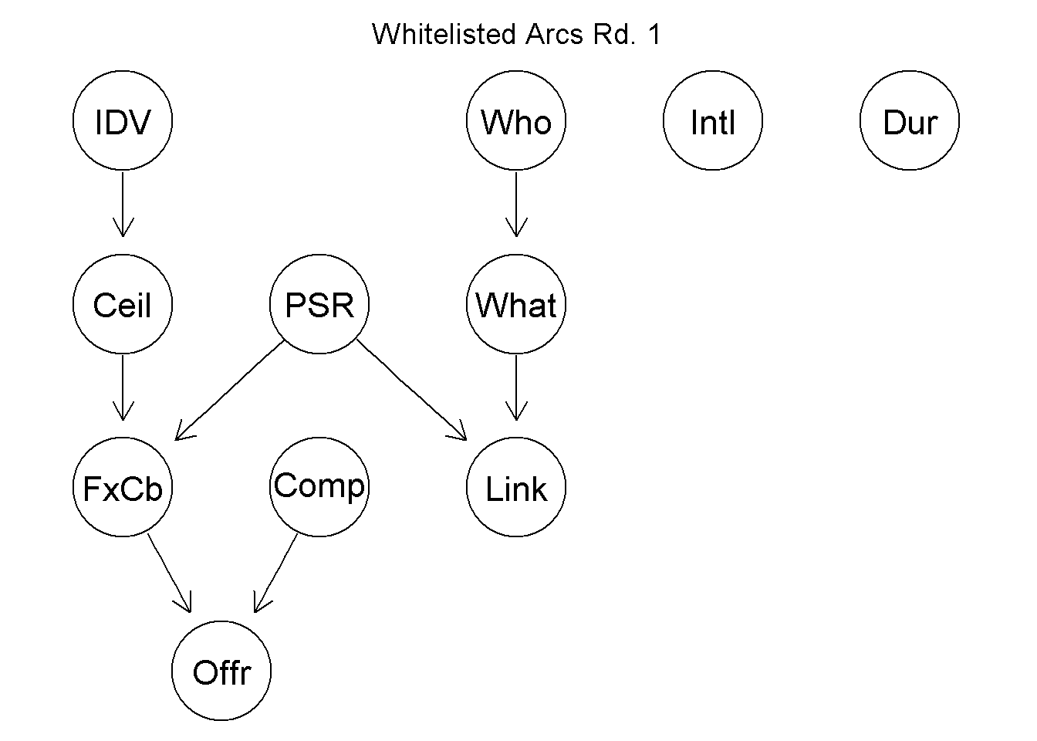
White List: Arcs which are required to present in the Bayesian model

Slide 9
Black List: Arcs which are not allowed in the Bayesian model

Slide 10
Resulting Bayesian Model

Slide 11
Hypothesis 1: Large R&D contracts will perform better as cost-based contracts
Support in Literature: Goel (1999) found “that the [contracting office] principal prefers a cost-plus contract in cases of large R&D projects or rising innovation benefits... The agent increases its research out-lays in response to a higher sharing rate when the expected rewards from innovation significantly exceed research costs.” Similarly Kendall (2015) describes low technical risk as a reason to choose fixed price contracts. Large R&D contracts are known for their technical risk.
Results:
Number of Offers: The hypothesis was supported, cost-based contracts had a substantially lower single offer competition rate, 22.5 percent for cost-based versus 29.7 percent for fixed price. Cost-based similarly had a higher rate of competition with five or more offer. This pattern held for long duration contracts and for aircraft contracts. In the latter case fixed price contracts received only a single offer 37.6 percent of the time versus 11.3 percent for cost-based! Cost-plus only loses its advantage for IDV contracts.

Slide 12
Hypothesis 2: Complex projects, as measured by pre-milestone B major defense acquisition project status, will perform better as cost-based contracts
Support in Literature: Bajari and Tadelis (2001) found that cost-plus contracts are preferred to fixed price contracts when a project is more complex (Bajari and Tadelis 2001).
Results:
Number of offers: The hypothesis was weakly supported using project interlinkages as a proxy for complexity. However, the results were not highly robust and were contradicted for two of the five controls. The single offer competition rate for cost-plus contracts was six percentage points lower for large contracts and two percentage points lower for aircraft. Since both large contracts and aircraft and drone contracts are associated with MDAPs, this suggests that the study team will need to refine linkages or test the hypothesis directly by looking at system equipment codes.

Slide 13
Hypothesis 3: Contracts with a longer duration will perform better as cost-based contracts
Support in Literature: Braucher (1953) found that “price redetermination might be used whenever contingency charges otherwise would be included in a contract price due to such factors as prolonged delivery schedules, unstable market conditions for material or labor, or uncertainty as to cost of performance."
Results:
Number of Offers: The hypothesized relationship did not hold. Unlike Hypothesis 2, the results appeared to be fairly robust. Overall, 25.3 percent of fixed price contracts with durations greater than a year receive only one offer compared to 31.4 percent of cost-plus contracts. This gap narrows to less than a percentage point for large contracts and aircraft and drone contracts.

Slide 14
Hypothesis 4: The potential for greater competition improves fixed price performance
Support in Literature: Goel (2001) argues that “[Government principals] would prefer a fixed-price contract when the number of bidders increases.” The hypothesis that fixed price contests are preferred by acquisition officials when they are likely to receive more competition may indicate that contracts that are more likely to be competed will perform better.
Results:
Number of Offers: This hypothesis is not testable with this dependent variable. However, given the high variability for the Number of Offers Received for fixed price contracts and the number of evidence nodes influencing both competition and number of offers, this hypothesis should be straightforward to test in future stages.

Slide 15
Hypothesis 5: Large software projects perform better as fixed price contracts
Support in Literature: Gopal and Sivaramakrishnan (2006) studied whether “the vendor's ability to leverage information asymmetry about capabilities and experiences translates into the vendor preferring Fixed-Price contract to secure larger information rents” and found support for “larger and longer projects with larger teams.” For this iteration, Electronics and Communications services were used as a proxy for software.
Results:
Number of Offers: Our results surrounding this hypothesis were inconclusive. We found that for small contracts, the hypothesis holds, with fixed price contracts nearly ten percentage points less likely to receive one offer compared to cost-based (28.8 percent versus 38.7 percent). However, this relationship reverses itself for large contracts. 29.0 percent of fixed price contracts receive only a single offer versus 21.2 percent of cost-based contracts.

Slide 16
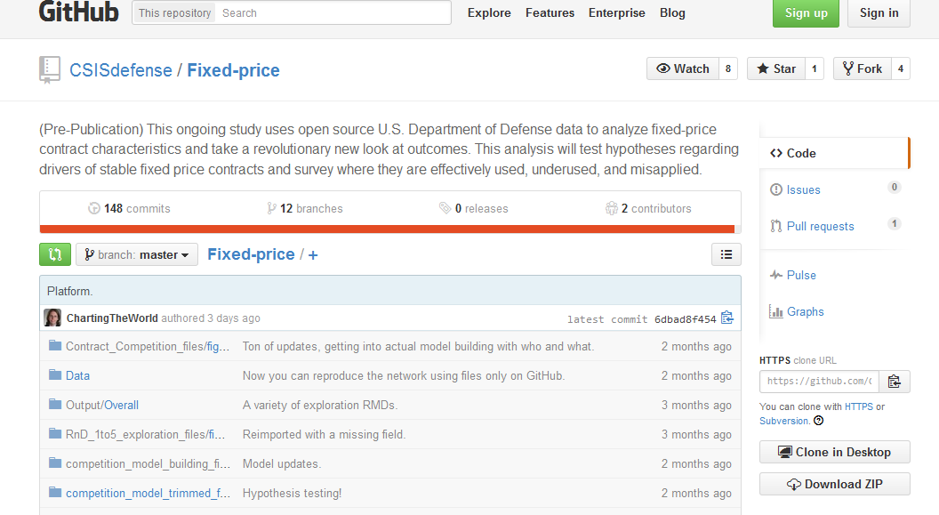
Releasing our data into the wild:
Our work in progress is available at http://www.GitHub.com/CSISdefense/Fixed-Price
As we clean up our interface
please contact
gsanders@csis.org
for walkthroughs and
to tune to your specific needs
(e.g. get only a sample of your
Preferred size)

